Slide 1
Lecture No. 31 Metallurgy
At the end of this lecture, students will be able to:
Explain concentration of zinc and nickel
Discuss the extraction and refining of zinc and nickel

Slide 2
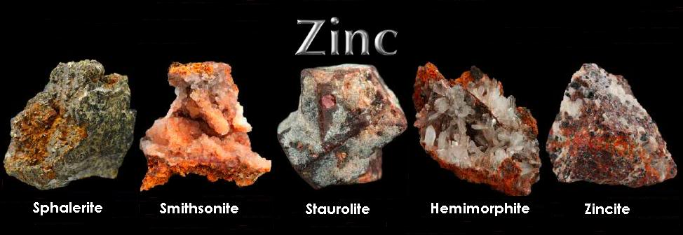
Metallurgy of Zinc
Occurrence:
Zinc is the 24th most available element in the earth crust
Soil contains 5 – 770 ppm of zinc
Zinc is not often found as a native element
Zinc is normally found with other metals such as copper and lead
It has low affinity for oxygen but high affinity for sulphur as a result zinc sulphide ores are quite common
Important ores:
Sphalerite, Zinc blende (Zn, Fe)S
Smithsonite, ZnCO₃
Hemimorphite, Zn₄Si₂O₇(OH)₂·H₂O
Wurzite, (Zn, Fe) S

Slide 3

Extraction of Zinc in ancient India
Extraction of zinc is one of the most difficult method since zinc is smelted around 1000ºC & it becomes volatile in the same condition Vaporized zinc is oxidized to zinc oxide easily and extraction become difficult
In India they used downward distillation of the zinc vapour formed after smelting zinc ore using specifically designed retorts with condensers and furnaces,
so the smelted zinc vapour could be drastically cooled down to get a melt that could solidify to zinc metal
Many Indian antiques from the past contain zinc which was not available in many parts of the world

Slide 4
Extraction of Zinc
The zinc or is crushed to powder and then treated by froth flotation to concentrate. It contains at least 50% zinc
Roasting was done to convert sulphide zinc ores to its oxide, by O2 flow & removal of SO2 at T of 700-800ºC
ZnS + 3/2 O₂ ZnO + SO₂
ZnS + 2O₂ ZnSO₄ (sometimes converted to sulphate)
ZnO is treated with carbon & limestone (CaCO₃) then O₂ is also supplied
Carbon monoxide is produced and reacts with ZnO to produce zinc
ZnO +CO Zn+CO₂

Slide 5
Extraction of Zinc
Zinc sulphate can be converted to ZnO by roasting
2ZnSO₄ + O₂ 2ZnO + 2SO₂ + O₂
Reduction of ZnO:
ZnO + C Zn + CO
ZnO + CO Zn + CO₂
Zinc metal may contain Fe, cd, Sb and As impurities. So it needs to be distilled in silica retorts
Volatile zinc is separated by distillation and non-volatile impurities remain in the container

Slide 6
Electro-refining of Zinc
The crude zinc oxide is dissolved in dilute sulphuric acid (H₂SO₄) to produce a solution of Zinc sulphate
ZnO+H₂SO₄ ZnSO₄ +H₂O
ZnSO₄ is used as the electrolyte
Lead (Pb-1%Ag) anode and an aluminum cathodes are used
When electricity is passed, O₂ is released at anode, while Zinc is
deposited on the cathode.
H₂SO₄ is regenerated at the anode and can be used again
Later, by melting zinc is removed
(m. pt of Zn = 420ºC & m. pt of Al = 660ºC)
Electrolytically refined Zn is 99.995% pure

Slide 7
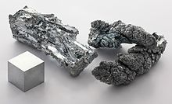
Physical properties of Zinc
Zn has bluish white color & brittle in nature
Malleable and ductile at 100 to 150°C
It is not affected in dry air but in moist air protective carbonate layer is formed
It is a reasonably good conductor of electricity and heat
densityof zinc is 7.140 g/mL

Slide 8
Chemical properties of Zinc
It forms oxide when heated in air
2Zn + O₂ ZnO
Boiling water is slowly decomposed by zinc
Zn + H₂O ZnO + H₂
Zinc dissolves readily in acids
2Zn + 2HCl ZnCl₂ + H₂
Zinc replaces less electropositive metals from their salts
CuSO₄ + Zn ZnSO₄ + Cu

Slide 9


Uses of Zinc
Galvanizing of iron is done using zinc which can protect iron from corrosion
Zinc plays a vital role in biology
Alloys of zinc have extensive applications in communication equipment, hardware, musical instruments, and water valves etc.
Zinc oxide is widely used as a white pigment in paints
It is useful in electrochemistry

Slide 10
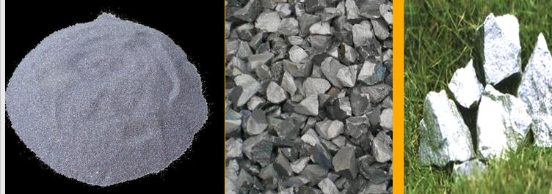
Metallurgy of Nickel
Occurrence:
Ni constitutes 0.02 % of the earth crust
Often found in the combined form
Nickel is found in very small quantity in India along with other ores of copper and gold
Important ores:
Pentlandite, (Ni, Cu, Fe) S
Violarate – Ni₂FeS₄
Nickel glance, NiAsS
Garnierite, (Ni, Mg) SiO₃.xH₂O
Smaltite, (Ni, ce, Fe) As₂

Slide 11
Extraction of Nickel
Ore [(Ni, Cu, Fe) S] is crushed and concentrated by froth-flotation
Ore contains many impurities like FeS, CuS, sulphur etc.
Ore is roasted in the free supply of air at high temperatures. This produces SO₂ and sulphur content is reduced and sulphides are converted to oxides
Smelting:
Roasted ore is smelted with coke, silica and lime stone where coke is the fuel & silica and limestone are the flux
They eliminate the impurities as slag

Slide 12
Extraction of Nickel
$FeO+SiO_{2} →FeSiO_{3} \left(slag\right)$
$CaO+SiO_{2} →CaSiO_{3} (slag)$
Slag being lighter floats and is eliminated
Matte layer contains NiS and CuS which are further roasted to form NiO and CuO
CuO is converted to CuSO₄ by the action of sulphuric acid and separated
NiO is treated with water gas and reduced to nickel
$$NiO+H_{2}+CO →2Ni+H_{2}O+CO_{2}$$

Slide 13
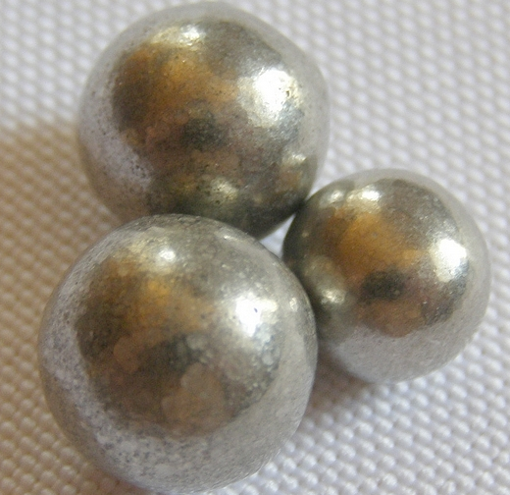
Refining of Nickel
Mond’s process:
Crude nickel is treated with CO and forms gaseous nickel carbonyl
But copper is unaffected and not forming carbonyl
Later the nickel carbonyl is decomposed to pure nickel
$$Ni+4CO → Ni(C{O)}_{4}$$
$$Ni(CO)_{4} → Ni \left(pure\right)+4 CO ↑$$
50 ºC
230 ºC

Slide 14

Refining of Nickel
Electro-refining:
Impure nickel forms anode and pure nickel forms cathode
NiSO₄ is used as the electrolyte
Electrolysis is carried out at 60ºC where the pure nickel is deposited on cathode
At anode, $Ni →Ni^{2+}+2e^{−}$
At cathode, $Ni^{2+}+2e^{−} →Ni (pure)$

Slide 15
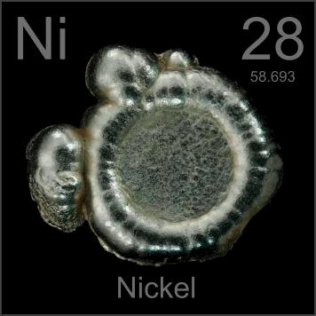
Physical properties of Nickel
Ni is a soft silvery white metal
Somewhat malleable and ductile
Melting point = 1420ºC; Boiling point = 2900ºC
Ni absorbs large amount of hydrogen gas
fairly good conductor of heat and electricity

Slide 16
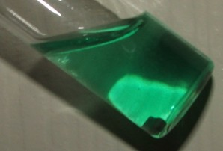
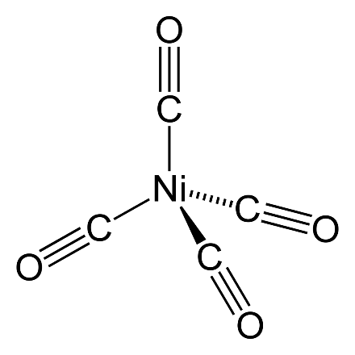
Chemical properties of Nickel
Reacts slowly in air but burns vigorously with oxygen when heated
Dissolves in nitric acid and forms nickel nitrate
$$3Ni+8HNO_{3} →3Ni(NO_{3})_{2}+2NO+H_{2}O$$
It remains unaffected by alkalis
When exposed to CO around 50ºC it forms a volatile colorless nickel tetra carbonyl
$$Ni+4CO → Ni(C{O)}_{4}$$
50 ºC

Slide 17


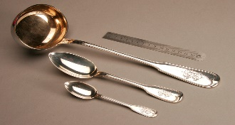
Uses of Nickel
Due to high melting point and resistance to corrosion nickel is used as crucibles, dishes and chemical wares
Nickel is used as a catalyst for hydrogenation of oils and fats
Important alloying elements used in chemical processing, space research and nuclear reactor
Ni-Cu alloys are used in chemical oil industry and electric industry
Ni, Cu, and Zn alloys are known as German silver. It is used for manufacture of ribbons, bands, and wires for various applications.

Slide 18
Summary
Zinc is the 24th most available element in the earth crust
Zinc sulphides are converted to oxides and then reduced to metallic zinc
By electro-refining zinc is purified
Ni constitutes 0.02 % of the earth crust
Ni is extracted from the sulphide ores and then purified either by Mond’s process or electro-refining

